Slide 1
Increment 2
Team 3

Slide 2
Increment Planning
Functional and Nonfunctional Requirements

Slide 3
Sprint Plan
50 Points

Slide 4


Scenarios

Slide 5

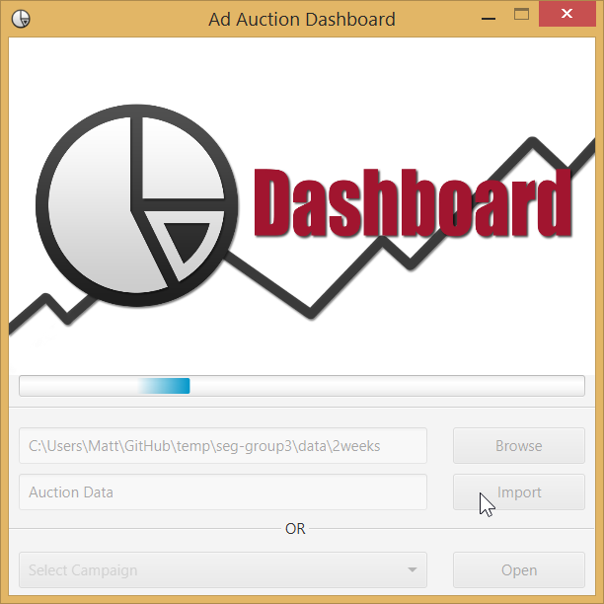
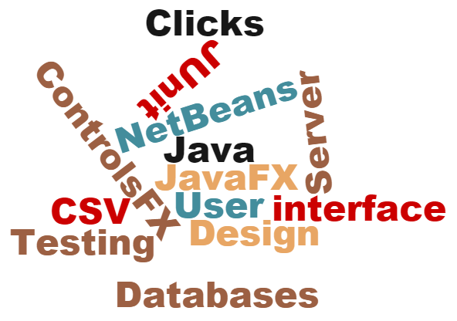
Design Choices

Slide 6
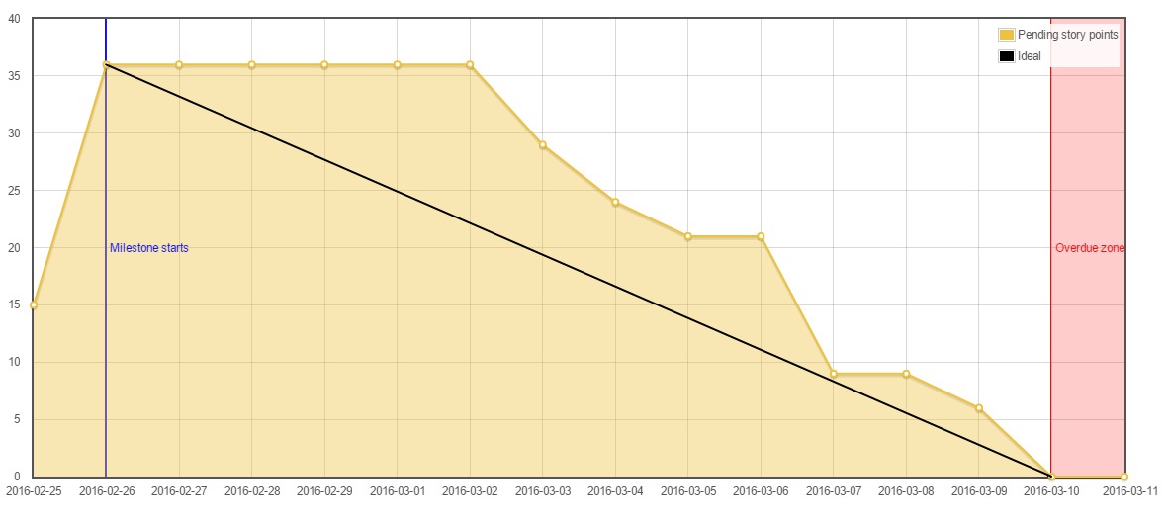
Burndown Chart

Slide 7
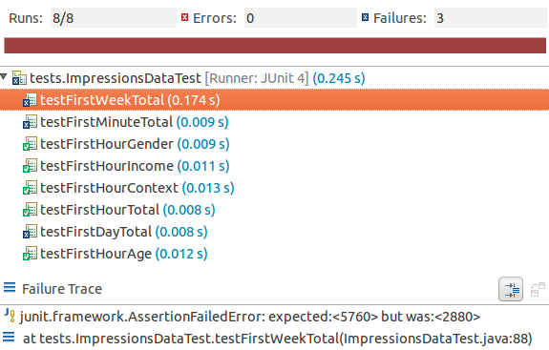
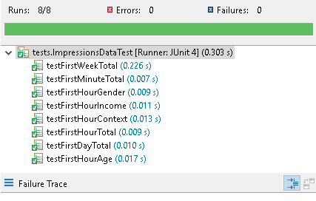

Testing
JUnit

Slide 8
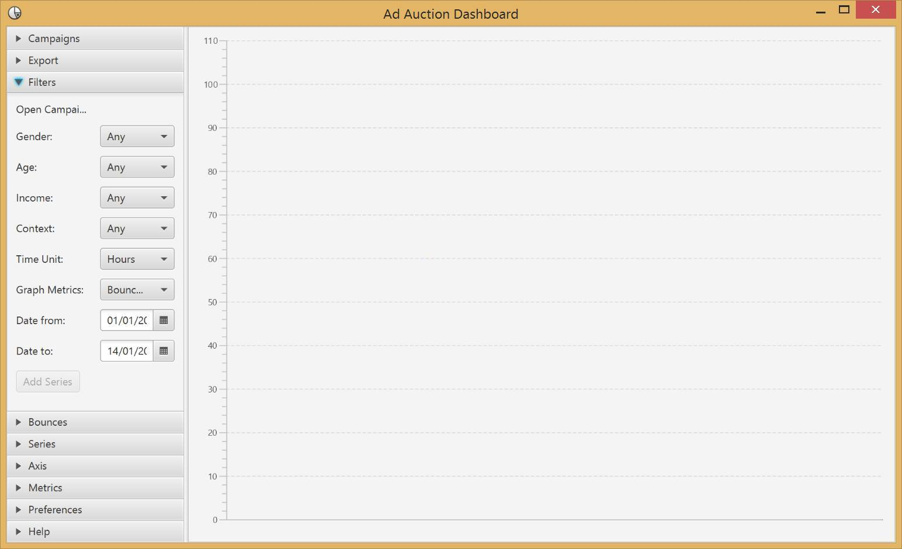
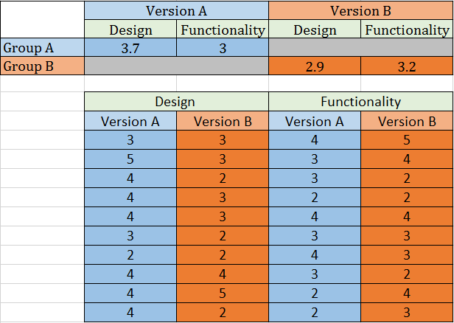
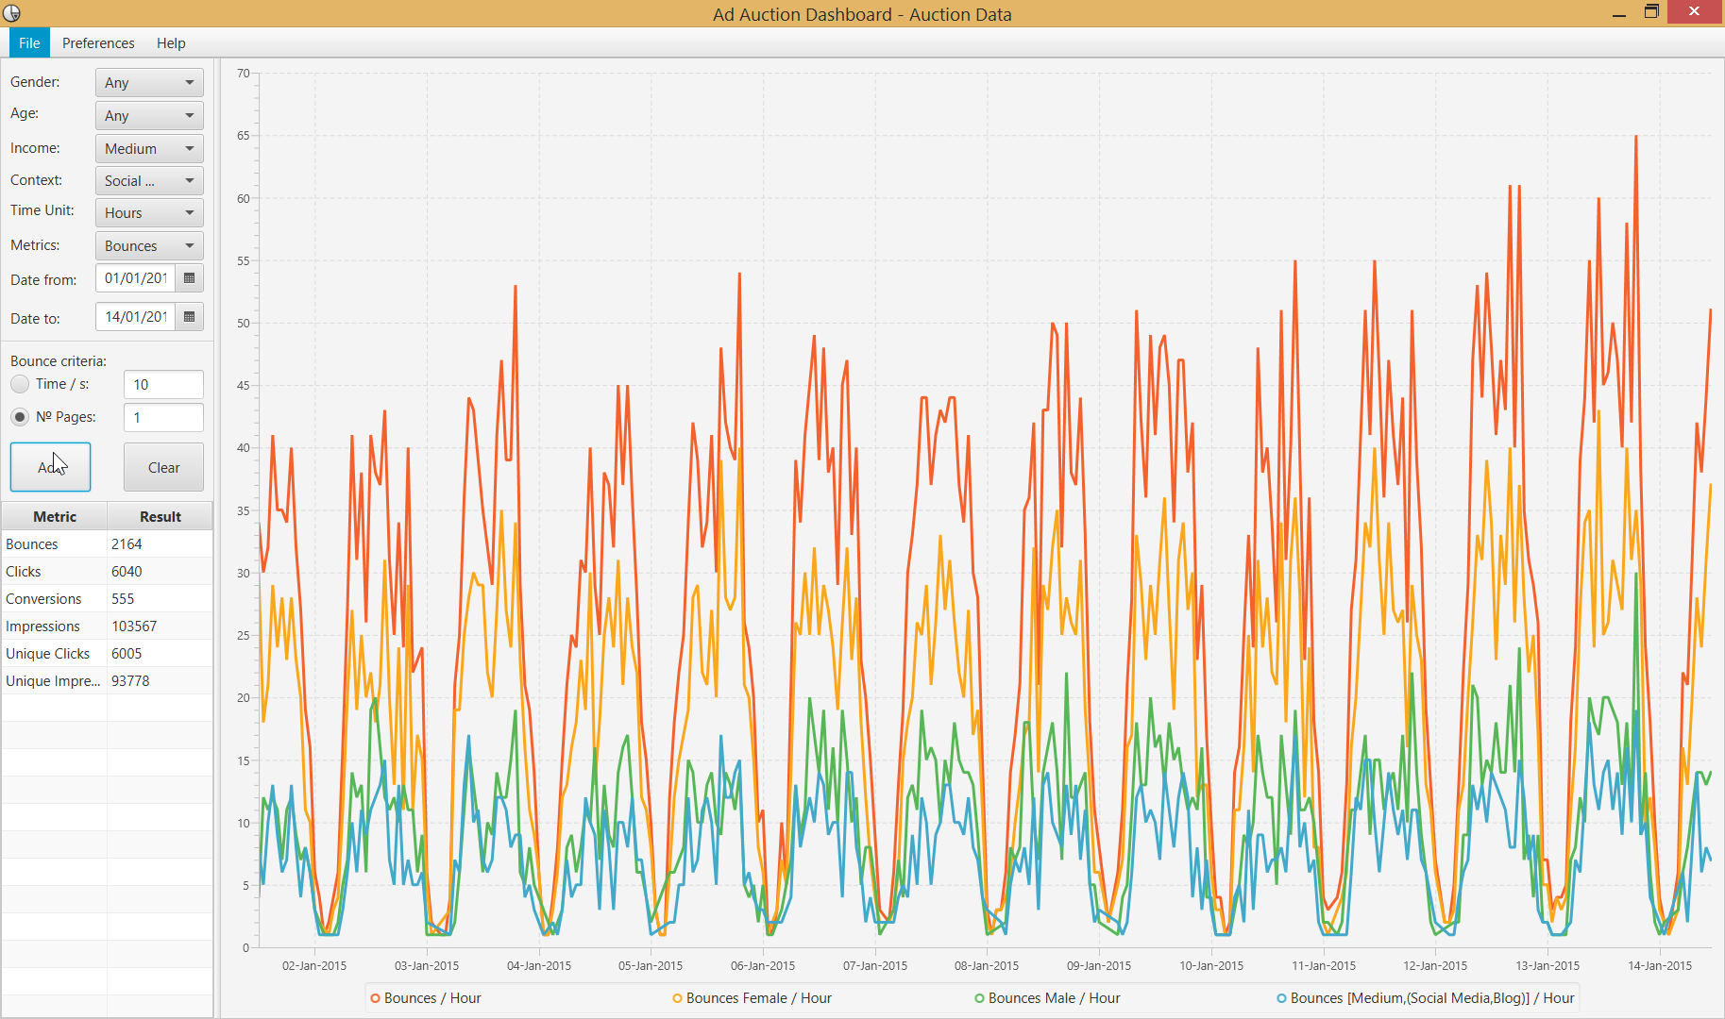
Testing

Slide 9
Thanks for Listening
Now the Demonstration

